Slide 1

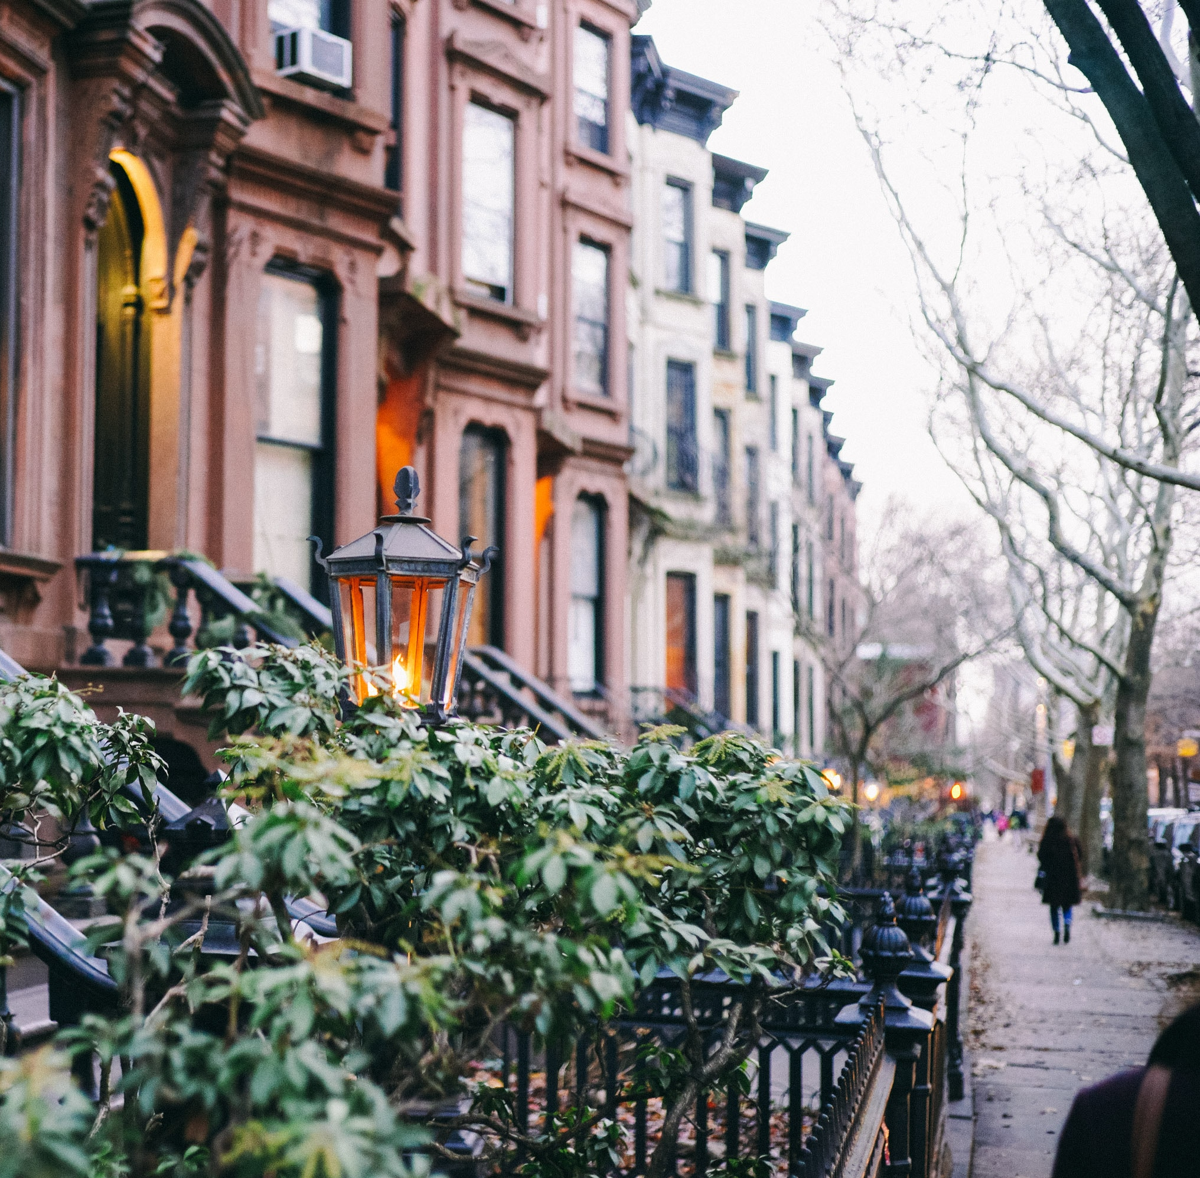

Slide 2

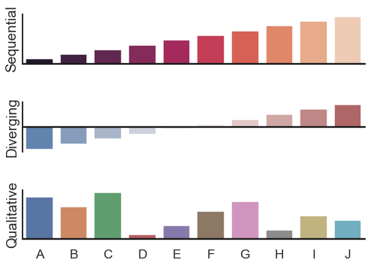
1
Objective
2
Sales Overview
3
Dashboard
3
4
Seasonality of Housing Price
AGENDA
4
5
Now or Never Neighborhoods
6
Investment Recommendation

Slide 3

OBJECTIVES
Identify the most Happening and upcoming Neighborhood in All 5 Boroughs in terms of Sale Price, Best Education, Low crime rate and other parameters.

Slide 4

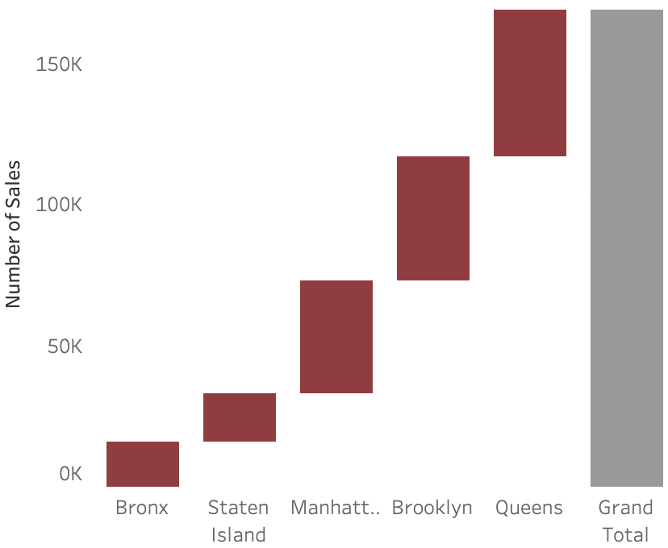






Sale Overview
169K
Number of Sales Occur from 2017-2019
Queens is the hottest borough for the past 3 years
30.7%
100%
26.0%
94.9%
85.8%
23.6%
Residential
Built Before Year 2000
One Family Dwellings
23.6%
$40M
Highest Sales Price
10.3%
9.4%
$650K
Median Residential Price
+9.3%
Changes In Median Sales Price

Slide 5
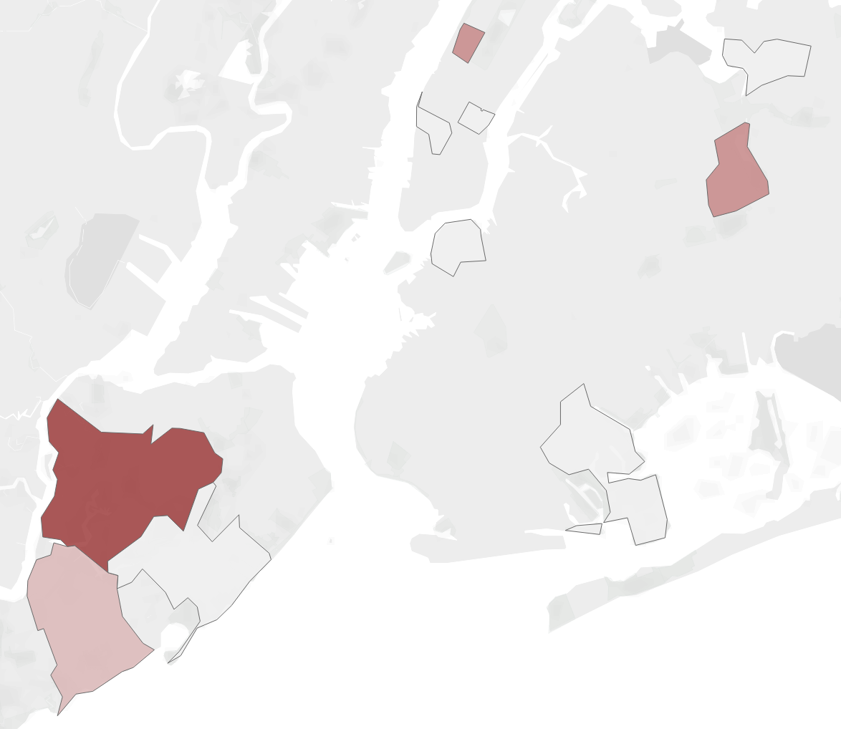
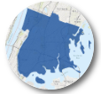
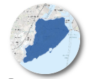
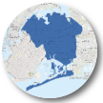
Explore Sales by Neighborhood
Bronx has largest growth on median prices
Top number of sales 2017 - 2019
17.3%
11.4%
10.5%
2,512
UPPER WEST SIDE
Bronx
Staten Island
Queens
2,465
FLUSHING
FORST HILLS
Flushing
HOTTEST NEIGHBORHOOD
Largest number of sales in 2019
Chelsea
HIGHEST VALUE AREA
Highest percentage change
3,067
Gowanus
HIGHEST VALUE NEIGHBORHOOD
Highest percentage change
NEW SPRINGVILLE
BULLS HEAD

Slide 6
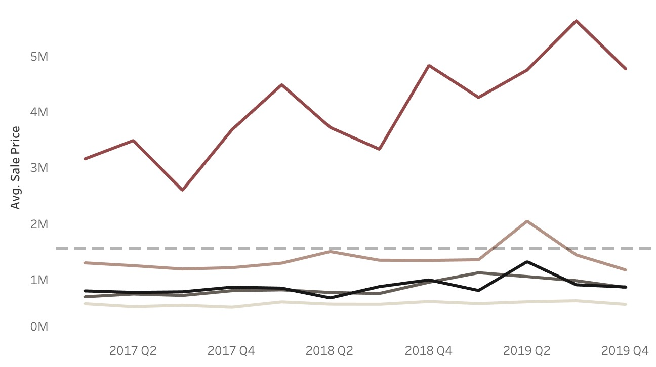
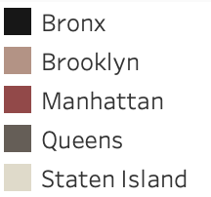
Seasonality of Sales
July, August and September has the least sale prices
$1.2M
Average Sale Price

Slide 7
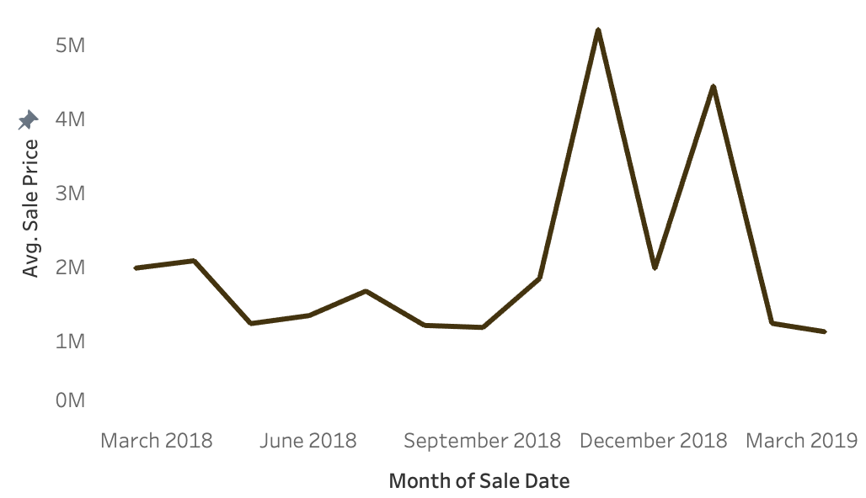
Does Event Affect Sales in NYC?
Be careful of news events, which may affect house prices
Amazon News Affect the Property Price in Long Island City
Increase
183%
Announced the second headquarter to NYC
Decrease
260%
Withdrawn the headquarter offer

Slide 8
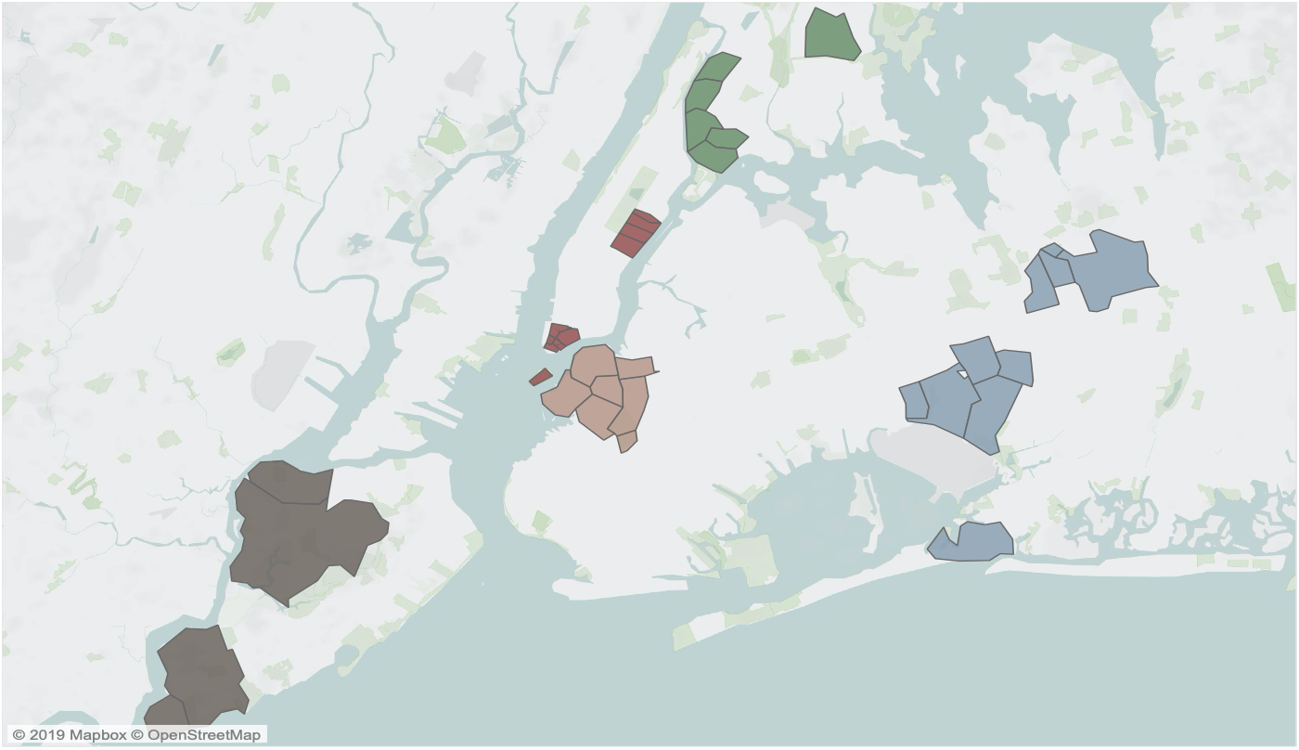






Now or Never Neighborhood
15 Neighborhoods showed peak increase in per sq. Ft. Sale price and have confident potential for Future Sales
Brooklyn
13
15
1. Gowanus - $5,671.5
2. MetroTech - $1,209.4
3. Fort Greene - $764.5
14
Queens
11
4. Glen Oaks - $3,610.3
5. Far Rockaway - $1,418.1
6. Springfield- $776.1
4
10
12
Staten Island
3
7. Rossville/Port Mobil - $2,211.6
8. Richmond Valley - $757.6
9. New Springville - $240.6
7
6
1
2
Manhattan
10. Financial - $3,810.3
11. Upper East - $3,518.9
12. South Bridge - $1,657
9
5
Bronx
13. Morris Heights - $400.8
14. Port Morris - $346.6
15. Pelham Gardens- $263.2
8

Slide 9









Gowanus,
Brooklyn
862 violent crime
1574 property crime
Per 100k People
9 Coffee Shops
19,941
population
2 Parks
Easy Shopping
$86,903
Median Income
10 Grocery Stores
Health Guarantee
5 Hospitals nearby,
3 of them in closing neighborhood
45% are college graduates
12 Schools
83% of graduation rate
$1.1M
Median House Price
Better Commute
38 Minutes Average Commute Time

Slide 10

Glen Oaks,
Queens
Low Crime Rate
130 violent crime
650 property crime
Per 100k People
6 Coffee Shops
7,690
population
$78,280
Median Income
5 Grocery
Stores
3 Parks
3 Hospitals nearby
$0.3M
Median House Price
High Education Level
41% are college graduates
14 Schools
82% of graduation rate
Transportation
42.6 Minutes Average Commute Time

Slide 11

Rossville,
Staten Island
Low Crime Rate
130 violent crime
265 property crime
Per 100k People
5 Coffee Shops
21,102
population
3 Parks
$86,333
Median Income
6 Grocery
Stores
Health
Guarantee
10 Hospitals nearby
$0.5M
Median House Price
31% are college graduates
6 Schools
83% of graduation rate
Transportation
44.6 Minutes Average Commute Time

Slide 12

Pelham Gardens, Bronx
Low Crime Rate
34 violent crime
623 property crime
Per 100k People
5 Coffee Shops
19,167
population
Space to Hang Out,
Natural
9 Parks, close to the largest park in NYC
$76,969
Median Income
Easy Shopping
7 Grocery Stores
4 Hospitals
Nearby
$0.6M
Median House Price
28% are college graduates
11 Schools
82% of graduation rate
Transportation
1hr 8 Minutes Average Commute Time

Slide 13

Financial District,
Manhattan
941 violent crime
5094 property crime
Per 100k People
A Lot of Places to Hang Out
30 Coffee Shops
30,247
population
Easy Shopping
$134,906
Median Income
18 Grocery Stores
17 Parks
10 Hospitals
Nearby
$1.1M
Median House Price
Highly Educated
Residents
Transportation
85% are college graduates
33 Schools
88% of graduation rate
21 Minutes Average Commute Time

Slide 14

THANK YOU

Slide 15
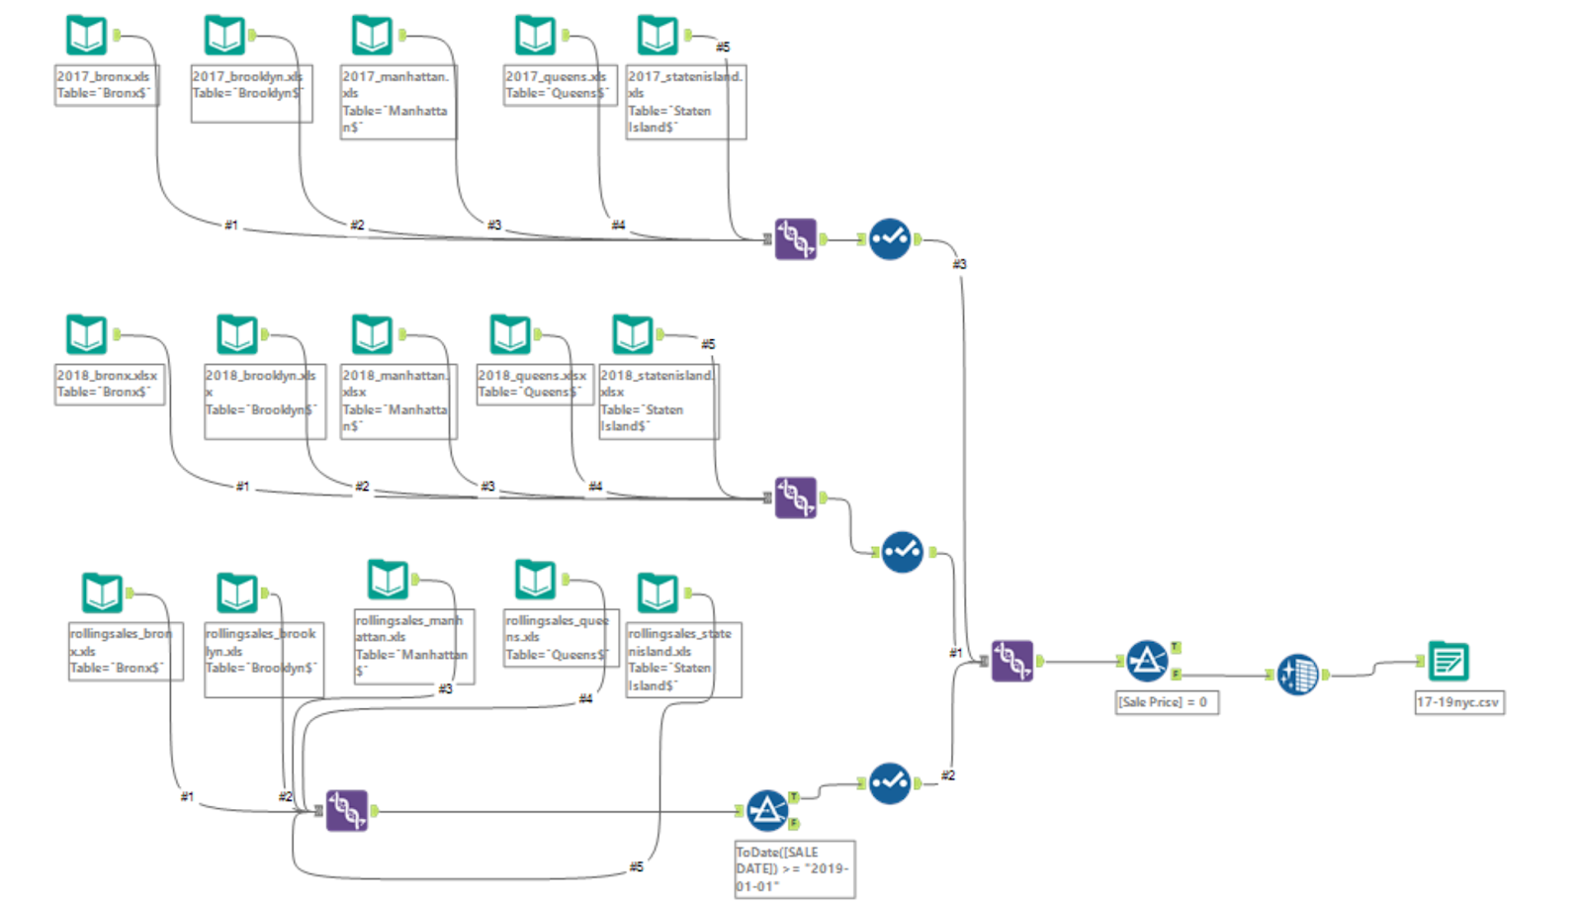
Appendix
We had datasets of the 5 different boroughs for each year, 2017, 2018 and 2019.
We had to create a union of all the data.
Had to make sure the data from the 5 boroughs for 2019 starts from 1/1/2019 to avoid duplicate entries.
After the union of all 5 boroughs from all 3 years, we removed the data which had sale price as 0.
Cleaned the dataset and exported it.

Slide 16
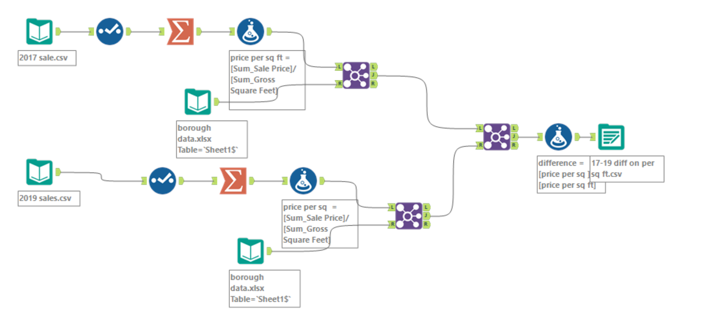
Appendix
Took the 2017 sales data set, checked it, did a summation of all sales for each neighborhood.
Calculated the price per sq. ft.
Joined the dataset with borough data.
Repeated this for 2019 sales.
Then joined both the data sets and calculated the sales difference per sq. ft and exported the result.

Slide 17
Sources
“EDFacts Data Files: U.S. Department of Education.” Home, US Department of Education (ED), 25 Jan. 2019, https://www2.ed.gov/about/inits/ed/edfacts/data-files/index.html.
“Fast City, Slow Commute.” Center for an Urban Future (CUF), https://nycfuture.org/data/fast-city-slow-commute.
Google Maps
Resident, Current. “Living in Financial District.” Niche, 16 Aug. 2017, https://www.niche.com/places-to-live/n/financial-district-new-york-city-ny/.
Resident, Current, and Niche User. “Living in Pelham Gardens.” Niche, 17 July 2019, https://www.niche.com/places-to-live/n/pelham-gardens-new-york-city-ny/.
Resident, Current. “Living in Glen Oaks.” Niche, 25 Oct. 2019, https://www.niche.com/places-to-live/n/glen-oaks-new-york-city-ny/.

Slide 18
Sources
US Census Bureau. “American Community Survey (ACS).” The United States Census Bureau, 5 Nov. 2019, https://www.census.gov/programs-surveys/acs/.
User, Niche. “Living in Rossville.” Niche, 20 Dec. 2015, https://www.niche.com/places-to-live/n/rossville-new-york-city-ny/.
Visitor, and Niche User. “Living in Gowanus.” Niche, 29 Nov. 2018, https://www.niche.com/places-to-live/n/gowanus-new-york-city-ny/.
York, City of New. “NYC Property Sales.” Kaggle, 22 Sept. 2017, https://www.kaggle.com/new-york-city/nyc-property-sales.

